Slide 1

MYSQL Housing Loan Management System Project
Caleb Salvi
ITVedant
Prof Sandip Gupta
November 16, 2024

Slide 2
Database summary
The HomeLoan database is designed to manage information related to customers, loan types, loan applications, approvals, payments, and branch operations. It provides a comprehensive system to streamline loan processes, including customer data management, loan tracking, payment updates, and branch-level operations

Slide 3
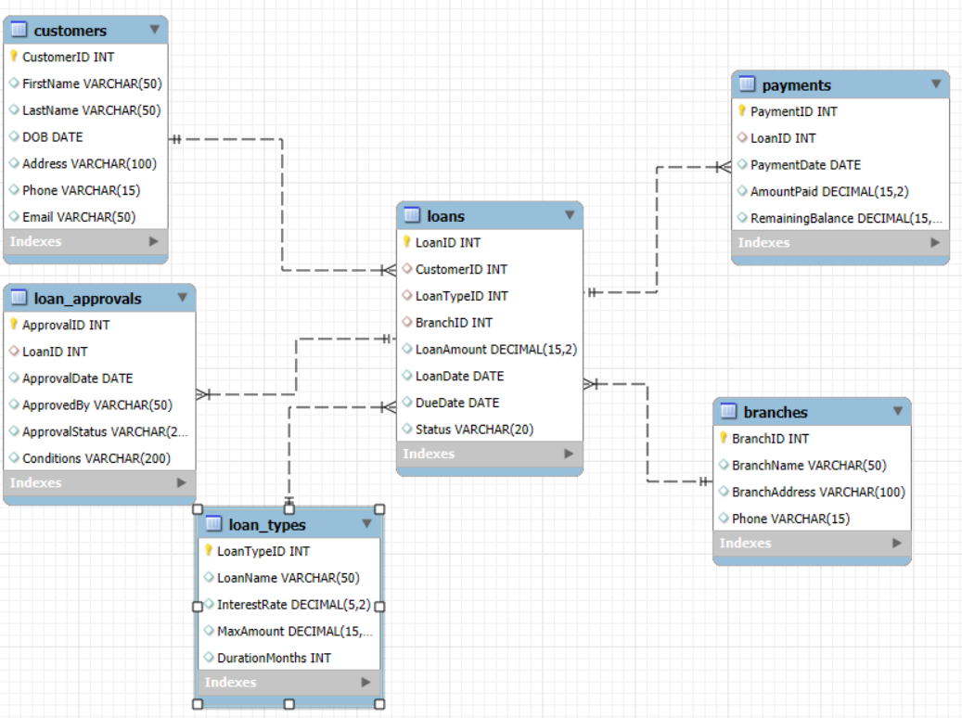
ER Diagram

Slide 4
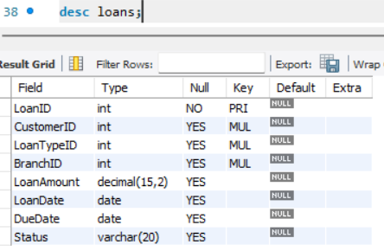
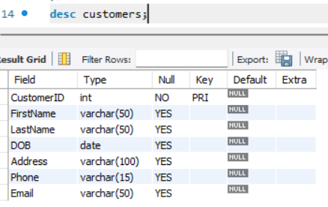
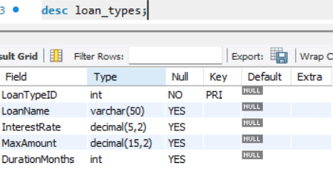
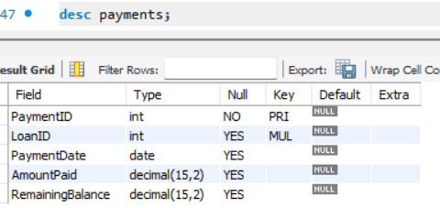

Slide 5
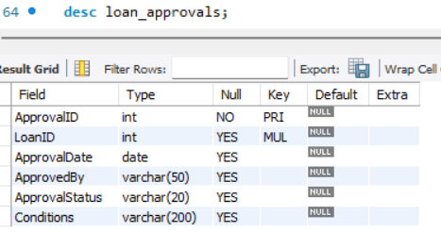
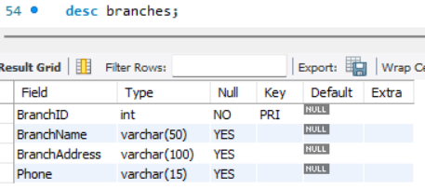

Slide 6
Project Objective
The objective of this project is to develop a robust and efficient database management system for a home loan institution to:
Store, organize, and manage customer and loan-related data effectively.
Track loan applications, approvals seamlessly.
Monitor repayment progress and outstanding balances.
Provide insights into branch-level operations for better decision-making.

